Slide 1
Dcard Popular Posts Prediction
0816131 蔡佩君 0816061 王凱俐
Team 6

Slide 2
Outline
Dcard Popular Posts
Data Collection
Data Analysis
Data Preprocessing
Model
Result
Demo

Slide 3

Dcard
Popular Posts
Posts that gather people’s attention rapidly within 36 hours

Slide 4
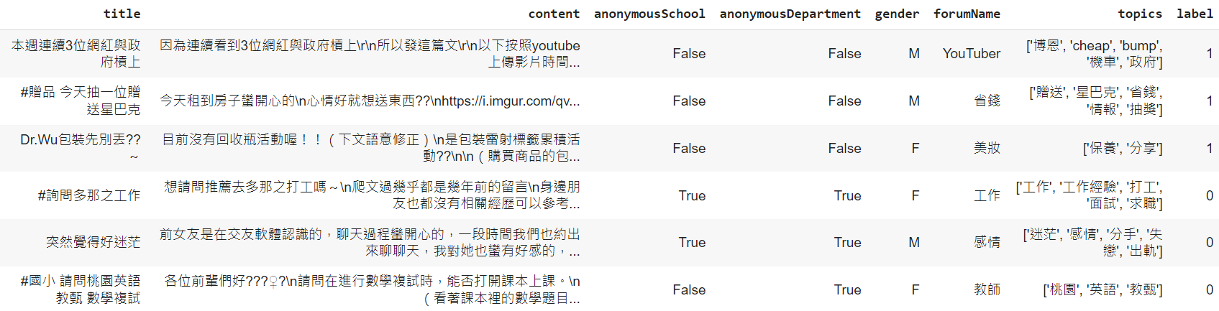
Data Collection
Popular/Not Popular

Slide 5
Data Collection
Popular Posts
Not Popular Posts
50%
50%

Slide 6
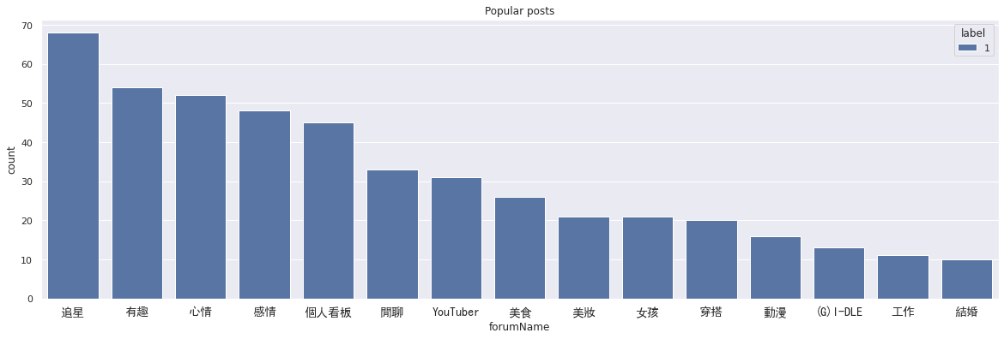
Data Analysis
Popular Forum

Slide 7
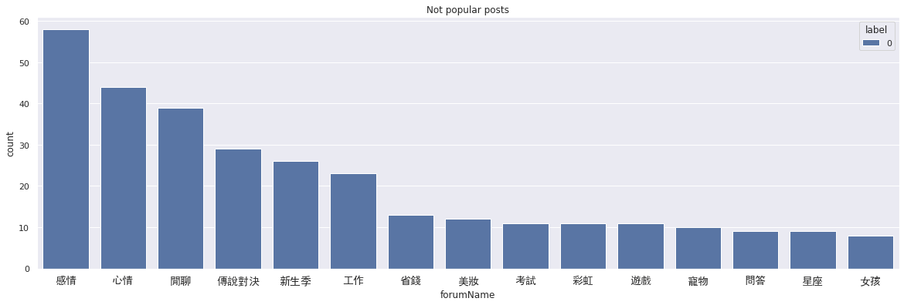
Data Analysis
Not Popular Forum

Slide 8
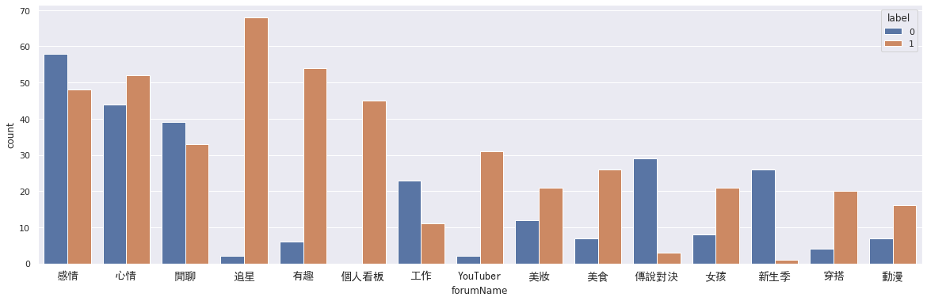
Data Analysis
Popular and Not Popular Forum

Slide 9
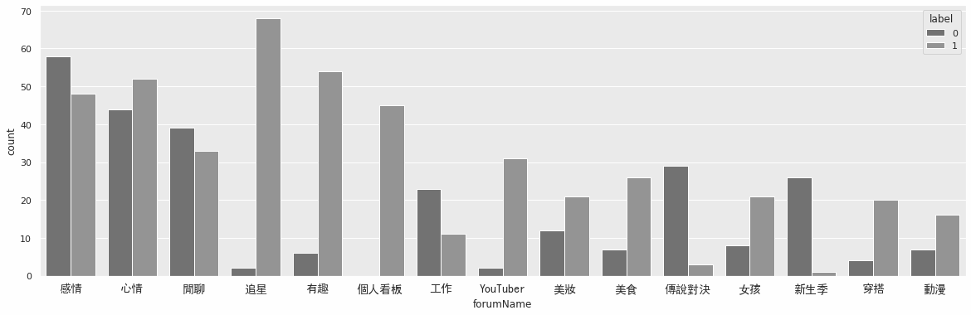
Data Analysis
Popular and Not Popular Forum

Slide 10
Data Analysis
Popular and Not Popular Forum

Slide 11
Data Analysis
Popular and Not Popular Forum

Slide 12


Data Analysis
Popular Title
Not Popular Title

Slide 13


Data Analysis
Popular Topics
Not Popular Topics

Slide 14
Data Analysis
看板
追星、有趣、youtuber、穿搭
傳說對決、新生季、工作
IG、男友、穿搭、梗、歷史、新聞、偶像、小吃、影片
請益、詢問、請問、推薦、發問、排位、工作、活動
標題
有趣、穿搭、梗圖、迷因、搞笑、日常、美食、男友
工作、感情、請益、傳說、手遊、新生、愛情
標記

Slide 15
Data Preprocessing
Drop nan
Remove other symbols
TF-IDF
Label encoding
Remove stop words
Label Binarizer
Remove incomplete data
Ex: emoji😍 😎, URL, punctuation
Let model focus more on less common word
Encode categorical features with integers
Remove common words which are also meaningless
Encode the data into dummy variables

Slide 16
Model
Naive Bayes
Logistic Regression
MLP
K Nearest Neighbor
4 layers with dropout
K=10

Slide 17
RESULTS
 | Model
Metric | Naive Bayes | Logistic regression | MLP | KNN
Accuracy | 0.85 | 0.85 | 0.87 | 0.79
 | Metric
Model | Precision | F1 score | ROC AUC score
MLP | 0.8766 | 0.8696 | 0.8713

Slide 18
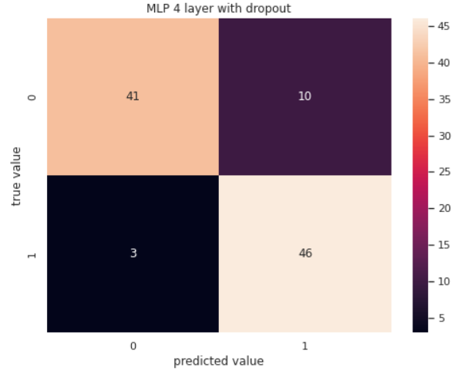
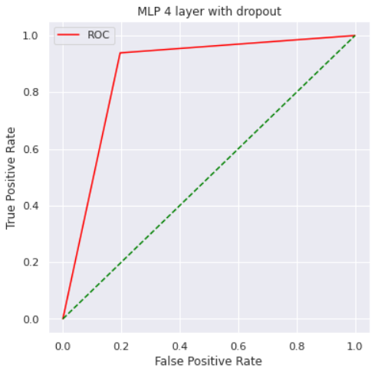
RESULTS
Confusion Matrix(MLP)
ROC curve(MLP)

Slide 19

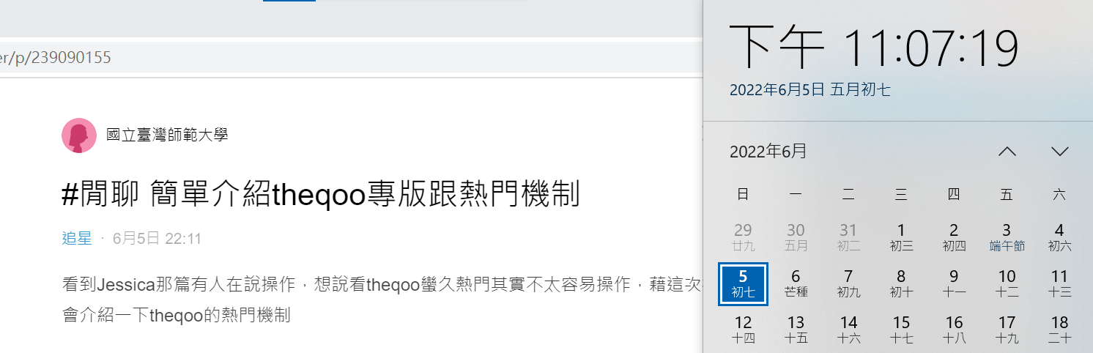
Demo

Slide 20
Demo

Slide 21

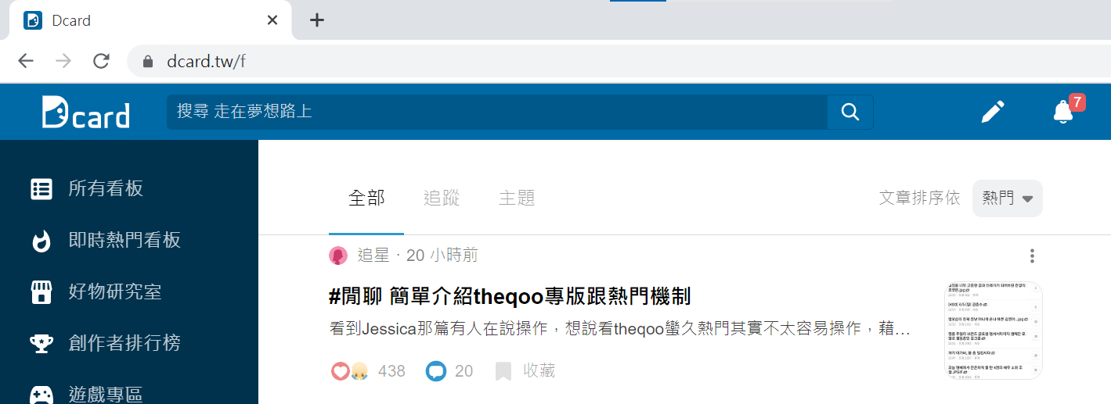
Demo

Slide 22
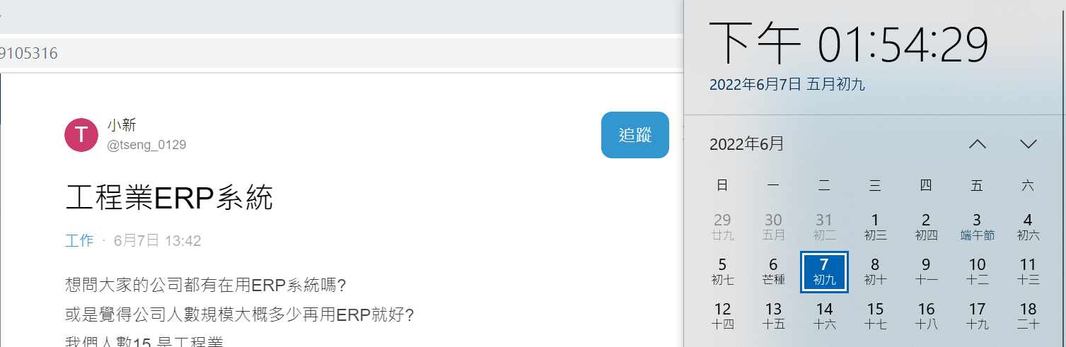
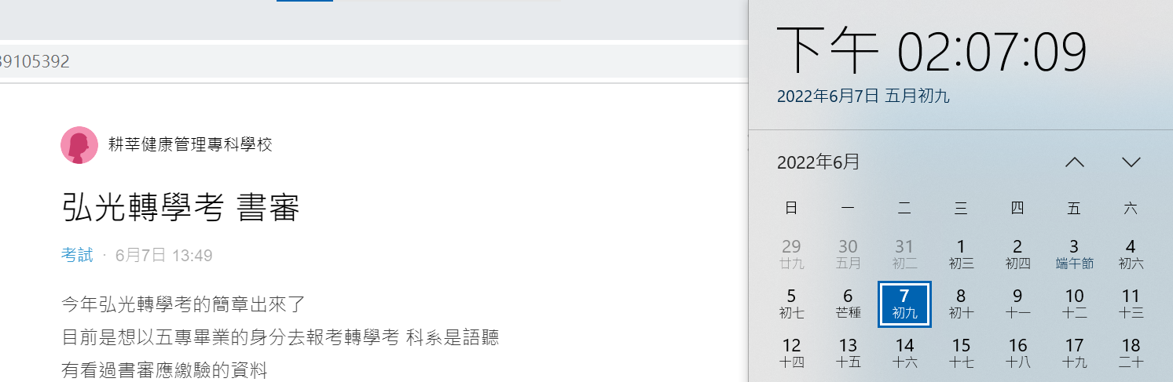
Demo

Slide 23
Demo

Slide 24
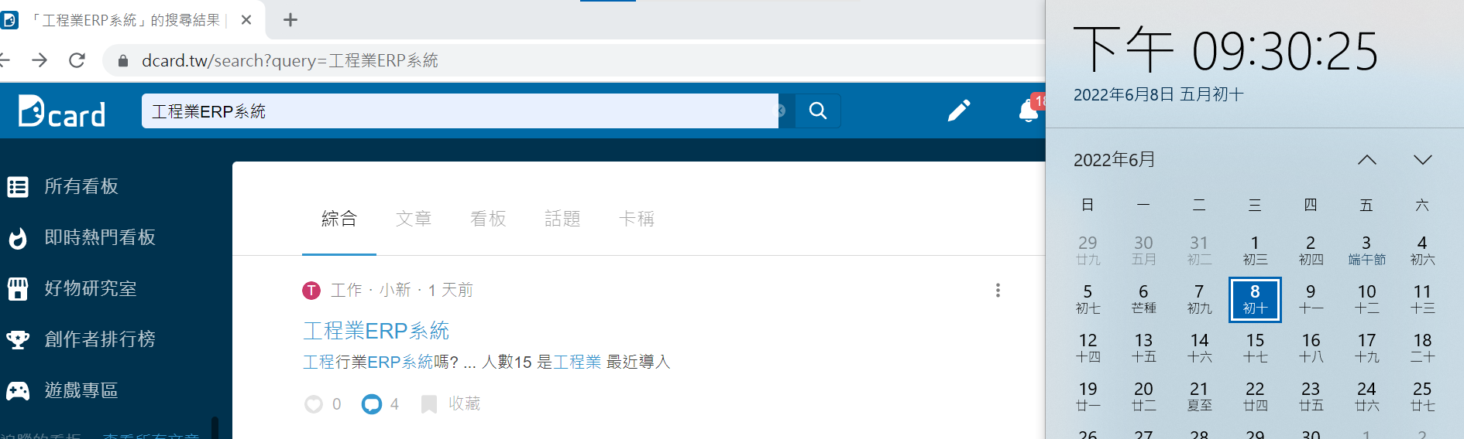
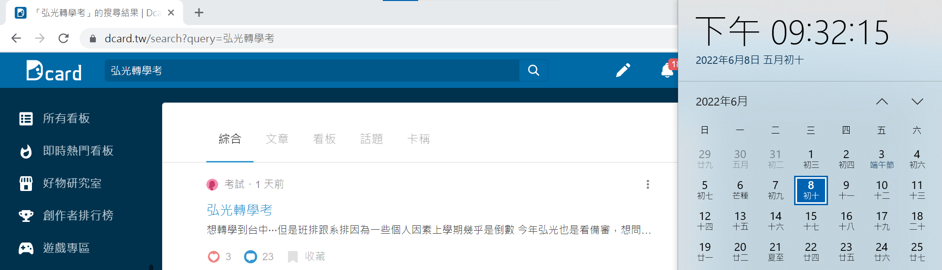
Demo

Slide 25
THANKS

